Slide 1
COMP2005 Introduction to Image Processing
Lecture 6
Connected Components
Morphology

Slide 2

Learning Outcomes
IDENTIFY
What is Connected Components
What is Mathematical Morphology
Erosion and Dilation
Opening and Closing
ROIs and Masks

Slide 3
Connected Components

Slide 4
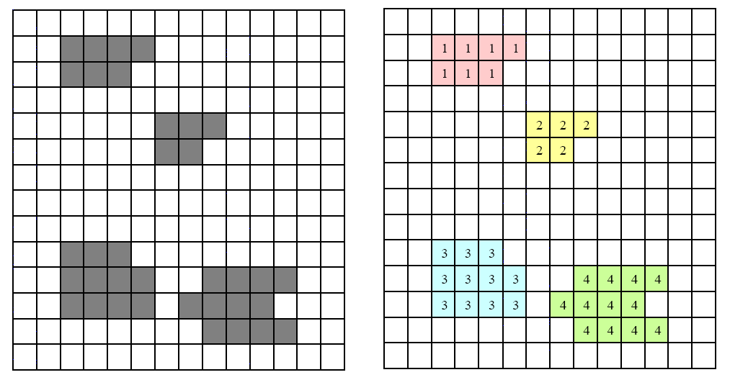
Connected Components
If black pixels are objects & white are background, give each connected set of black pixels a different label
Connected can mean 4- or 8- neighbours
REMEMBER

Slide 5
Connected Components
Connected component algorithms are slow and often a bottleneck
Keep a separate output array for labels
Two passes over the image
A sequential algorithm using 4-neighbours
Scan image top left to bottom right
Look at top and left neighbours (already given labels)
Can we assign either of their labels to the current pixel?
First pass

Slide 6
Connected Components
If the current pixel is foreground, there are 3 cases:
left = top = background → assign current pixel a new label
one of left and top is background, the other foreground → assign current pixel the foreground pixel’s label
Left = top = foreground → assign current pixel one of their labels and note that their labels are equal in an equivalence table
Step 3 detects mergers between two previously separate components

Slide 7
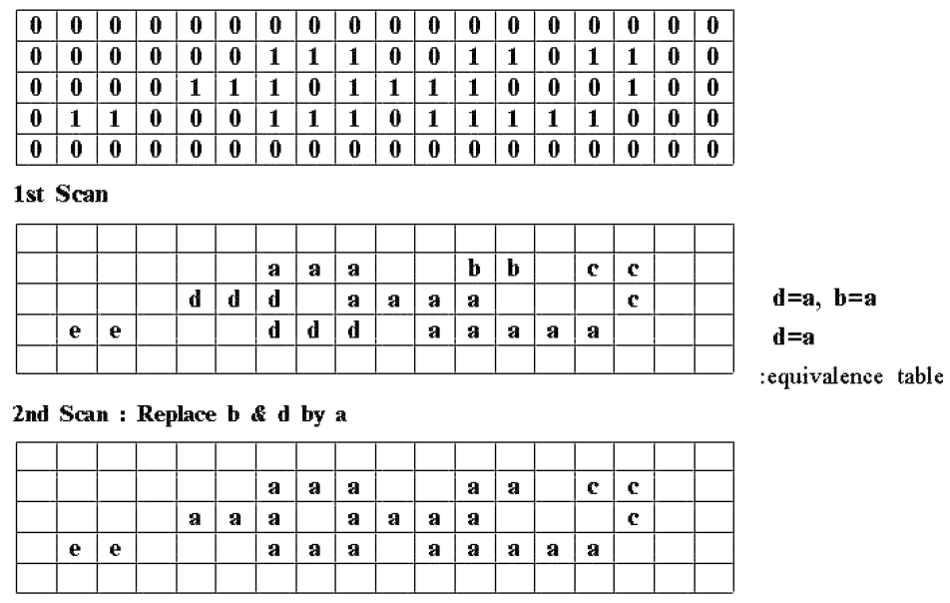
Connected Components
Consider each equivalent pair of labels, set all instances of the higher label to the lower
Second pass
Using 8 neighbours makes the algorithm (a little) more complex and gives (slightly) different results

Slide 8
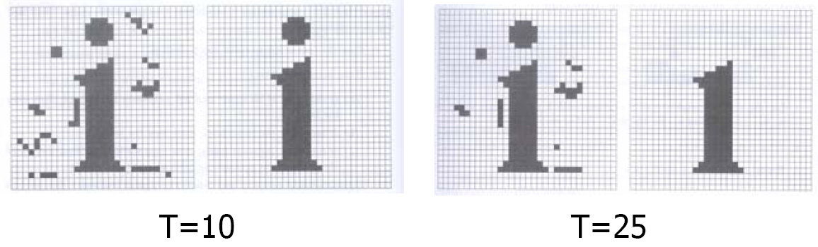
Connected Components
Can compute features of and apply tests to components to process the underlying image
e.g., apply a (size) threshold T to the number of pixels in the component
Shape is captured by measures like area/boundary length
Many application-specific features and tests exist

Slide 9
What is Mathematical Morphology

Slide 10
Mathematical Morphology
A branch of image processing which treats images as sets of pixels and uses set theoretic operations to process them
Developed for binary images, extended to grey level images
Elements of sets are (x,y) coordinates of black (or white) pixels
Perform operations by combining two sets:
A patch of the binary image to be processed
A Structuring Element, similar to the mask in a convolution process
Underlying mathematics is beyond the scope of COMP2032. Instead, we will focus on how they work in practice and what they do
DISCLAIMER

Slide 11
Structuring Elements
Binary masks, c.f. filter masks but identifying rather than weighting pixels
Larger structuring elements produce more extreme effects
Very similar effects can be achieved by repeated operations using a smaller but similarly shaped structuring element
With larger structuring elements, it is quite common to use an approximately disk-shaped structuring element
Need not be square, origin need not be in the centre

Slide 12
Morphological Operations
Expands a foreground (or background) object A using structuring element B
Dilation
Shrinks a foreground (or background) object A using structuring element B
Erosion
The boundaries between foreground and background are often smoothed in the process
The amount and the way objects grow and shrink depend upon the choice of the structuring element
Dilating or eroding without specifying the structural element makes no sense than trying to filter an image without specifying the filter

Slide 13
Erosion & Dilation

Slide 14
Dilation
2 inputs
Binary image to dilate
Set of points to be considered; a structuring element
Origin is the central element
1 | 1 | 1
1 | 1 | 1
1 | 1 | 1
The structuring element is superimposed on each of the background pixels such that origin of the structuring element coincides with the input pixel position
If any of the ‘1’ pixels in the structuring element overlap (intersect) the foreground then the background pixel is also set to foreground
Algorithm
(dilate foreground)

Slide 15
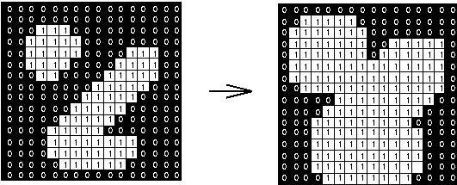
Dilation
Gradually enlarges the boundaries of regions of foreground pixels (i.e., white pixels, typically)
Areas of foreground pixels grow in size while holes within those regions become smaller
Result of dilation with a square 3 x 3 structuring element

Slide 16
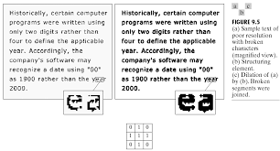
A More interesting Example

Slide 17


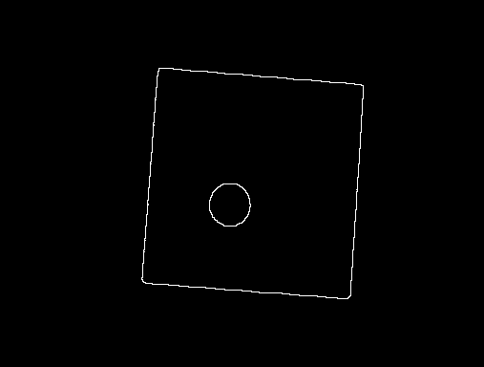
Edge Detection by Dilation
Dilation input image (note rounding of corners)
Subtract from original
Edges remain (pixels on the outside of the boundary)

Slide 18
Erosion
2 inputs
Binary image to erode
Set of points to be considered; a structuring element
Origin is the central element
1 | 1 | 1
1 | 1 | 1
1 | 1 | 1
The structuring element is superimposed on each of the foreground pixels such that origin of the structuring element coincides with the input pixel position
If any of the ‘1’ pixels in the structuring element overlap (intersect) the background then the foreground pixel is also set to background
Algorithm
(erode foreground)

Slide 19

Erosion
Result of erosion with a square 3 x 3 structuring element
Erosion is the dual of dilation, i.e., eroding foreground pixels is equivalent to dilating the background pixels with the same structuring element

Slide 20
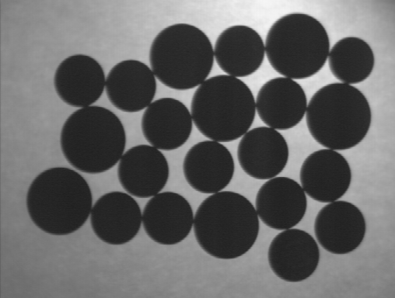
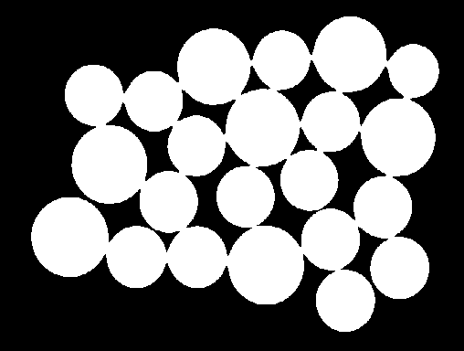
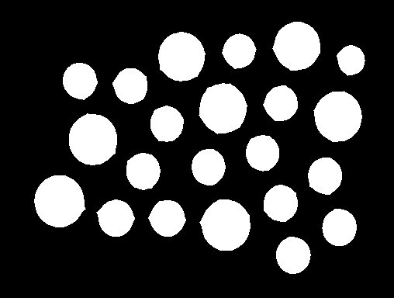
Erosion
Counting objects (cells, coins) can be difficult if they touch
Erosion can separate them
Erosion can be used for edge detection too – giving pixels on the inside of the boundary
REMEMBER

Slide 21
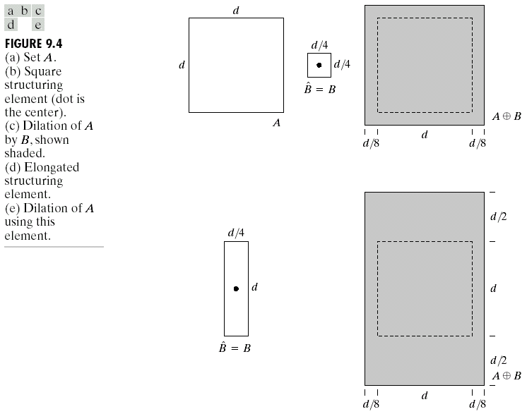
Asymmetric Structuring Elements
Dilation

Slide 22
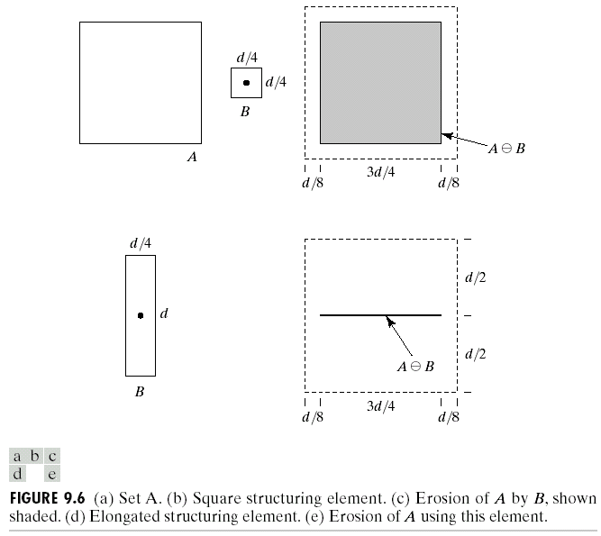
Asymmetric Structuring Elements
Erosion

Slide 23
Opening & Closing

Slide 24
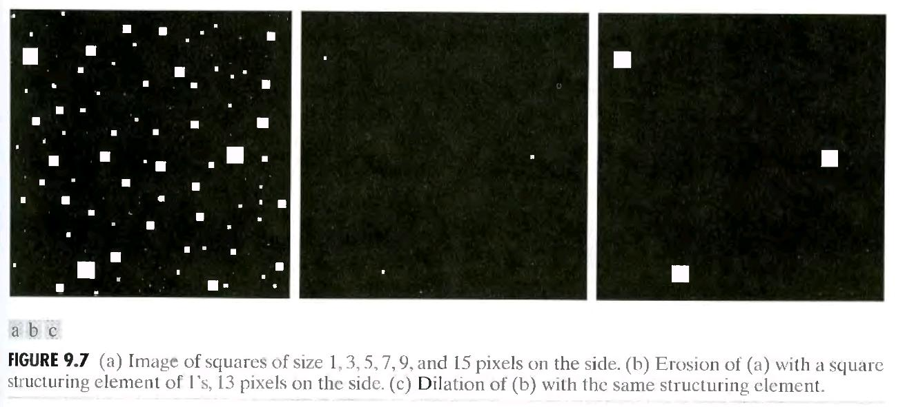
Combining Dilation and Erosion
Its rare to need only erosion and dilation, and they are much more useful when combined

Slide 25
Opening and Closing
First erode A with B, then dilate A with B
Smoothes contours, eliminates protrusions
Opening
First dilate A with B, then erode A with B
Smoothes sections of contours, fuses narrow breaks and long thin gulfs, eliminates small holes and fill gaps in contours
Closing
These operations are dual to each other
These operations can be applied multiple times, but have an effect only once (the first time)

Slide 26
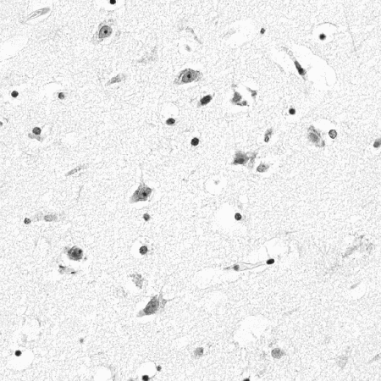
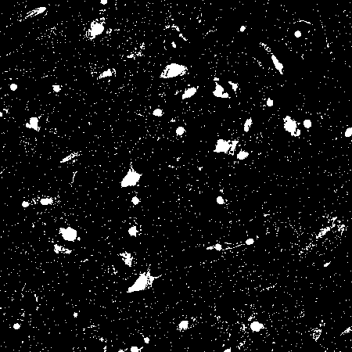
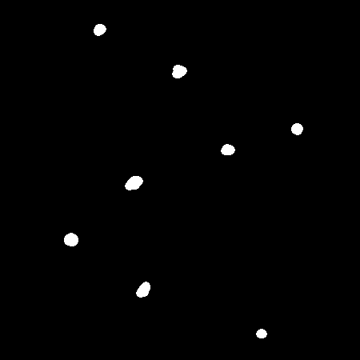
Opening
(a) Contains two kinds of cells: small, black ones and larger, grey ones. Thresholding with a value of 210 yields (b). Opening (b) using an 11 pixel circular structuring elements yields (c)
(a)
(b)
(c)

Slide 27


Closing
To retain only the large holes, we can simply perform a closing with a disk-shaped structuring element with a diameter larger than the smaller holes, but smaller than the large holes
The result of a closing with a 22 pixel diameter disk

Slide 28
ROIs & Masks

Slide 29
The Whole Image
All our examples so far have applied processes to the whole image – or section of image – input
The tools we have become more powerful if we can apply them to selected pixels, and more powerful still if the selection can be automatic
OpenCV supports Region of Interest Processing through NumPy array slicing
ROI Object Creation and Modification
Mask creation
ROI filtering

Slide 30
Python OpenCV
Supports filtering and inpainting of:
Manually defined rectangular ROIs
Interactively drawn bounding box ROIs
ROIs defined by any appropriately sized binary image
ROIs defined by colour
The concept of ROIs is very powerful; code can be written to allow the output of one process to determine where another is applied
REMEMBER

Slide 31
Summary
💡
What is Connected Components
What is Mathematical Morphology
Erosion and Dilation
Opening and Closing
ROIs and Masks
🤔

Slide 32
Questions

Slide 33
NEXT: Derivates and Edges

